Slide 1


Supine Team Presentation
Zack Hawkins
Josie Wood
Alexander Pritchard
Solomon Cammack
Notes:
Hello! We’re Supine, welcome to our team presentation! We’re going to introduce you to our project for the live client module, ‘Tap Tap Dungeon’, and break down the steps and procedures we took throughout development in order to create the final product.

Slide 2
Team Role Introductions

Slide 3
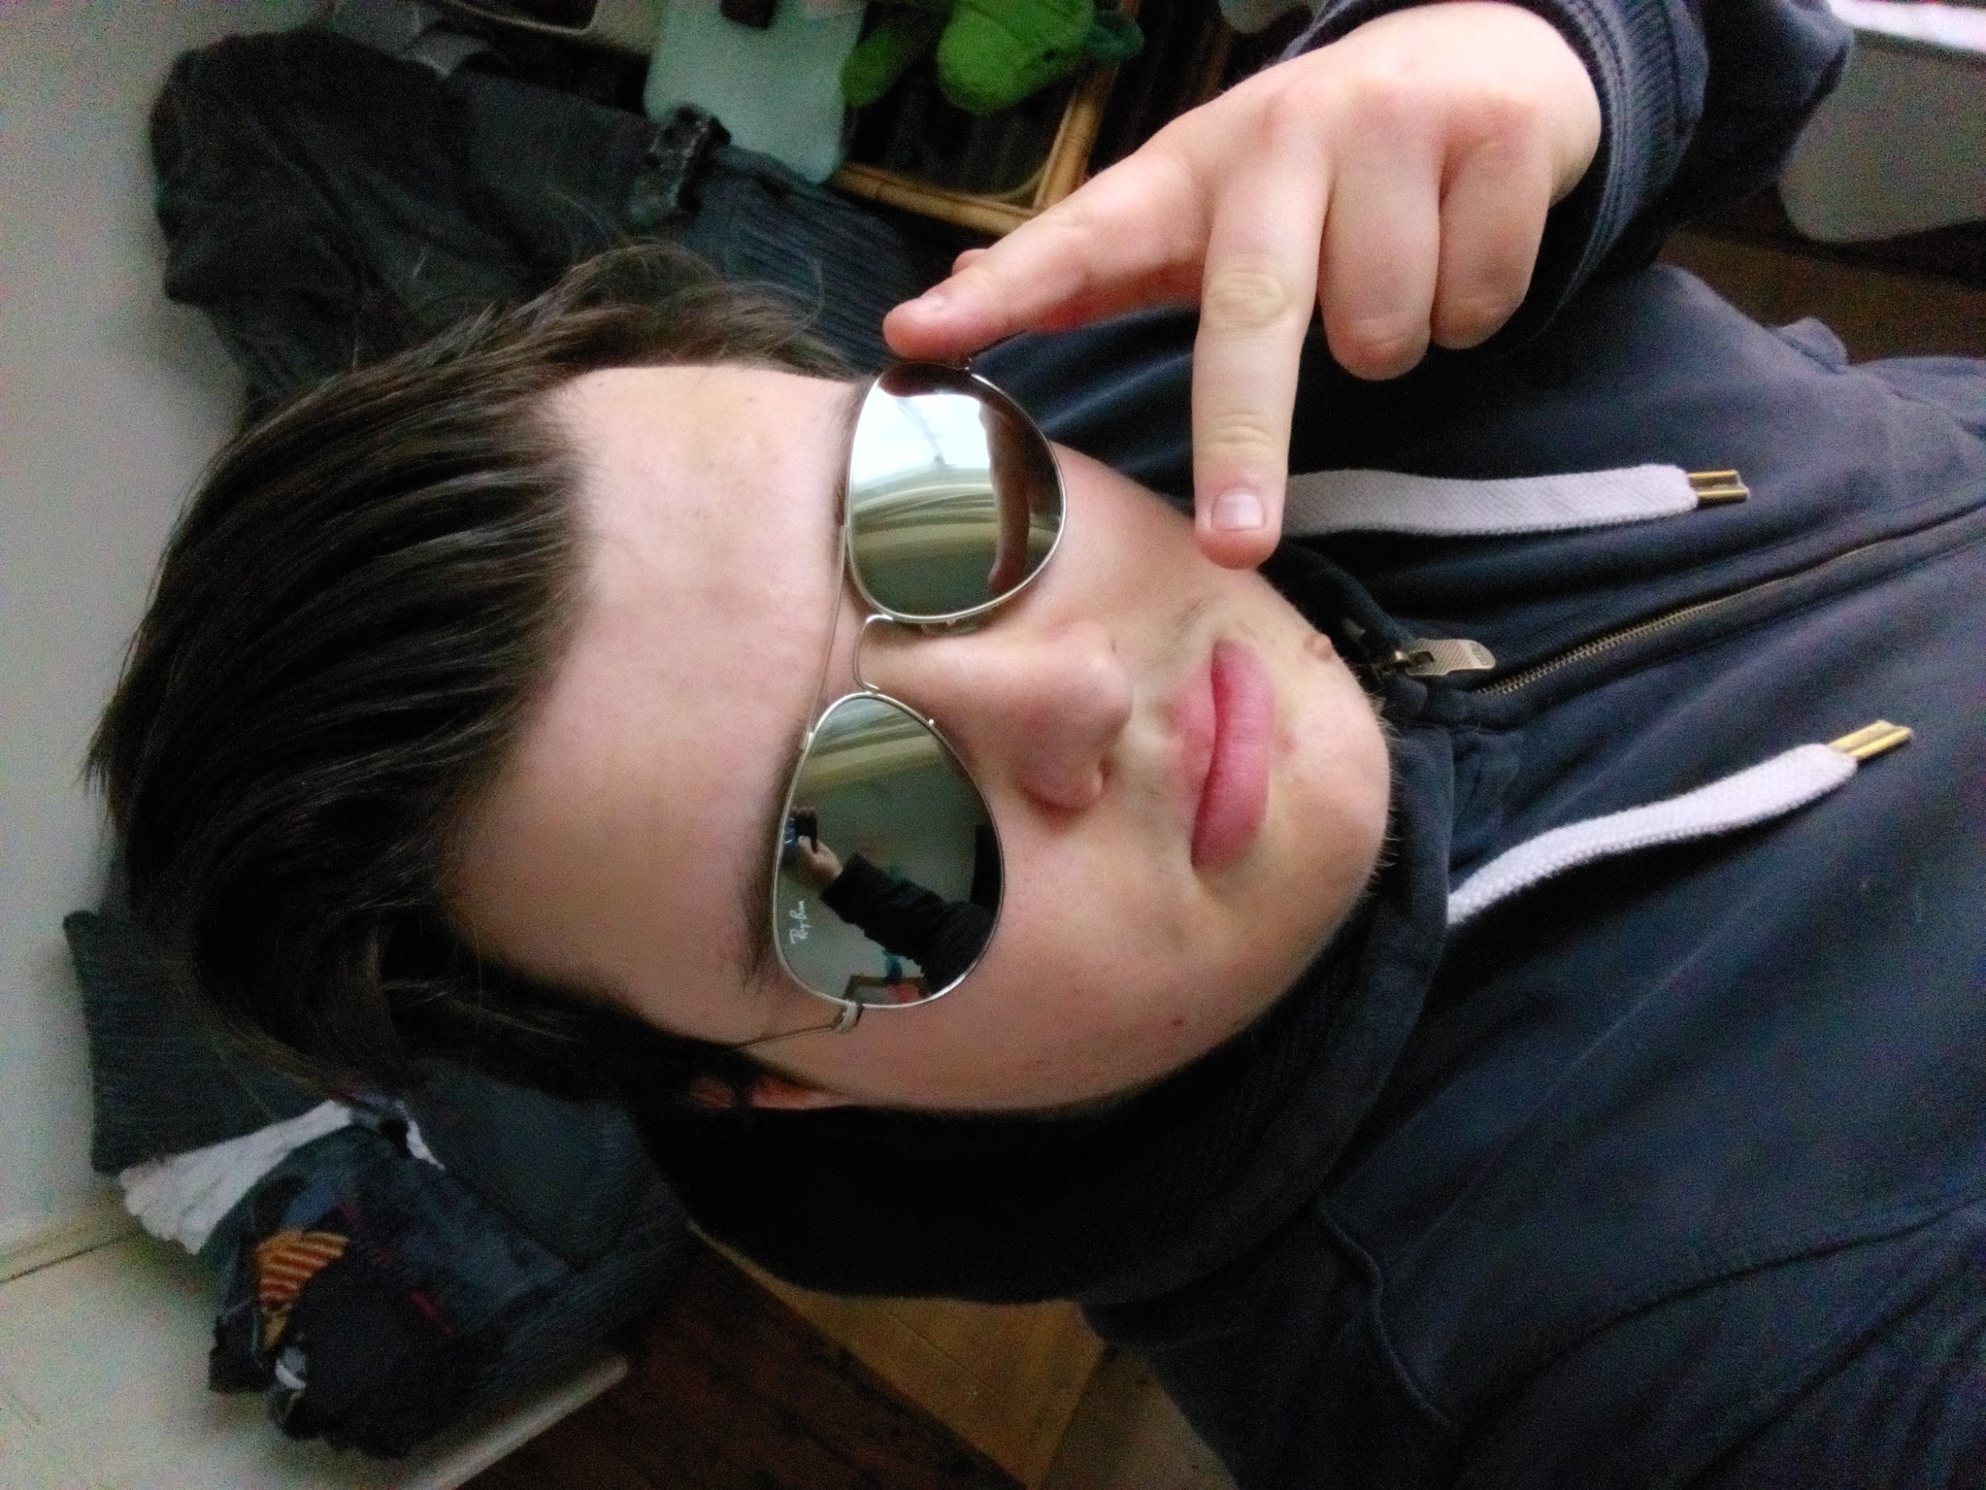

Zack
Primary Role:
- Product Owner
Secondary Role(s):
- Secondary Designer
- Client Liaison
@FichandChip_STU
Notes:
Hi, I'm Zack and I'm the product owner for team supine. This means that I was in charge of talking to the client throughout development of the project. Setting up meetings with the client each week, discussing what our goals for the project are and making sure they are aligned with their own. As well as this, I was also in charge of setting up the public testing. Gathering the feedback from that and analysing it. Finally, I am the secondary designer for the team so I was responsible for the visuals of the web-based aspects of the game.

Slide 4
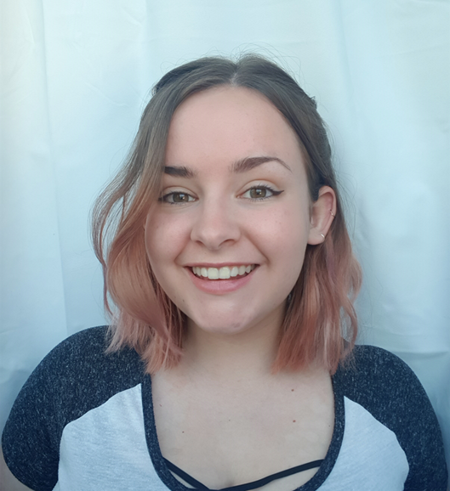
Josie
Primary Role:
- Scrum Master
Secondary Role(s):
- Lead Designer
- QA Tester
@DevJosie
Notes:
I’m Josie, my main role for this project was Scrum Master, so I was in charge of project management and ensuring we follow agile methodology. I’m also the Lead designer, which meant I was responsible for the visuals of the game, and made all the models myself. I also spent time each week doing Quality Assurance, to make sure all new features were working as expected without any bugs or issues.

Slide 5
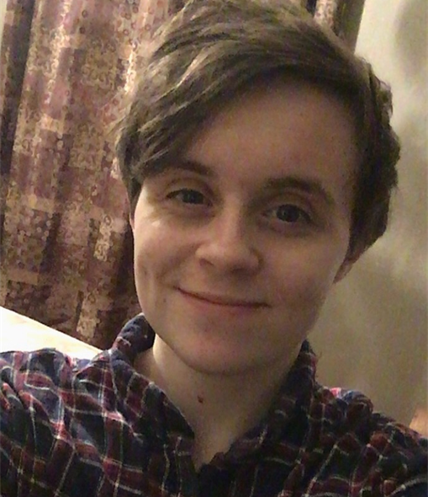

Alexander
Primary Role:
- Technical Lead
Secondary Role(s):
- Codebase Manager
- QA Tester
@alexpritc
Notes:
Hi, I’m Alexander, I’m the Technical Lead and Codebase Manager. I share the Technical Lead role with Solomon, but I am also in charge of most of the programming in the Unity Engine, declaring the coding conventions, and peer reviewing everybody’s code. I am also a QA Tester alongside Josie, and worked with her consistently to find defects in our solution.

Slide 6
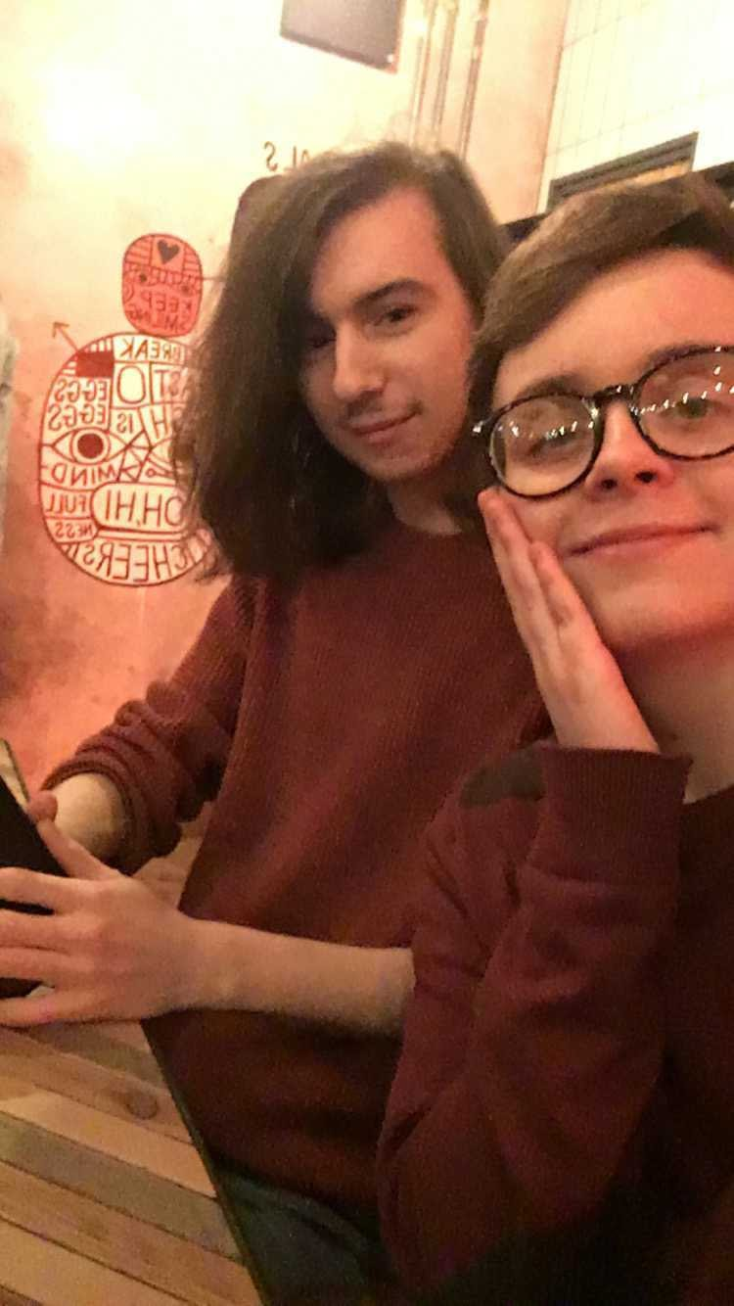
Solomon
Primary Role:
- Technical Lead
Secondary Role(s):
- Repo Manager
- Technical Relations manager
@slmnio
Notes:
[SOLOMON]
I'm Solomon, I'm a Technical Lead and the Repo Manager. I was in charge of our repository: enforcing our rules for branches and pull requests and did lots of peer reviews before merging. I helped to improve the quality of our code and health of our repository whilst also managing the external player 2 part of the project.

Slide 7
The Project

Slide 8
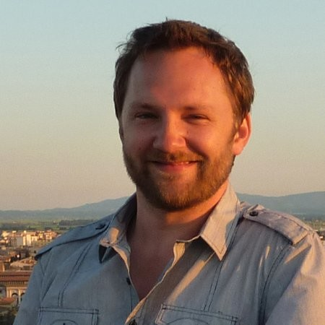

Our Client - Luke McGowan
Relevant info:
Freelance developer and designer
Plymouth Based
Experience with web design and game development in Unity
Luke McGowan
His Pitch:
Multiplayer game for all ages
To be played by him and his kids
Allow young children to be a part of their parents games
Notes:
Our client is called Luke McGowan. He has a past experience with web design as well as game development experience in unity. His primary job description is a freelance developer and designer. He came to us with a pitch for a game to be played with himself and his kids.
The pitch was a “multiplayer game for all ages”. He wanted a game that included his kids in the experience. Something that they could also enjoy playing as well as him. The reasons behind him looking for something like was because the games that are currently out there cover a wider variety of ages rather than being specifically designed for adults and children of a younger age to play. By focusing the age rating more, he wants a game that is both easy for the kid to grasp and enjoy as well as having the adult also have an enjoyable time.

Slide 9

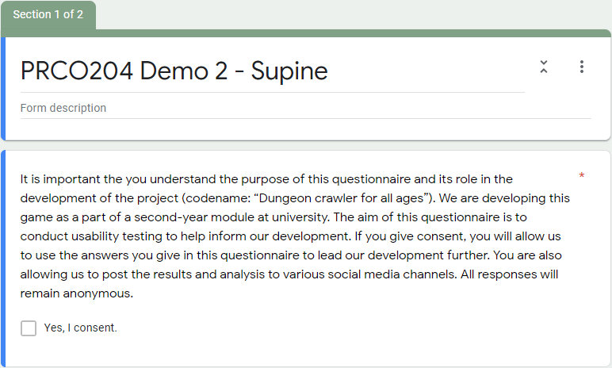
Legal, Social, Ethical and Professional issues
A game targeted at under 10s:
They don't need to enter any personal data or register an account
No explicit themes (e.g. gambling, sex, drugs)
No graphic violence or language
No microtransactions
Handling people’s data:
We asked participants in our user testing sessions to sign a consent form.
We explained who will see their data and what it will be used for (informed consent).
Notes:
Doing a game for children comes with a lot of issues (legal, ethical etc) and so we had to be very careful in how we proceeded with our development. There were some things we had to take into consideration when attempting a project like this.
Because this is a game targeted at children (under 10) we had to make sure that we didn’t collect any of their personal data. So we can’t have them registering an account or any other way of collecting their data. The game can’t contain any explicit themes (sex, drugs, gambling etc) as these are clearly not designed for the consumption of a younger audience. The game can’t contain any profanity or violence as it has to abide by the rules set by PEGI (pan european game information) committee. It can however contain a very mild form of violence (stylized or comical) but nothing frightening. Finally the game cannot contain any micro transactions as this raises ethical and professional issues designing a game made for children and including micro transactions.
Another aspect we had to consider was when we collected data from our user testing. We had to get the people testing our demo to sign a consent form making sure they understand what we are planning on using their data for to make sure we are doing this all legally.

Slide 10
Our Pitch
Dungeon crawler / room clear
Couple variations of enemies
Procedurally generated levels
Obstacles / traps that player 2 spawns / activates
Voxel based graphics
Distinct colour Differentiation between world, player and enemies
Tablet linked to main computer for player 2
Stylized map that shows live feed of player 1 (main game)
Matches art style of primary game.
Help / hinder premise
Notes:
After meeting our client and hearing his pitch, we brainstormed as a team to come up with ideas that met his specifications. We settled on a dungeon crawler esc style of gameplay that was based on a help/hinder mechanic as well as a room clear style of gameplay. This meant that the child would control an invincible overseer that would look down on player 1 as they progressed the dungeon and could at any point decide to help the player by giving them support or hinder them by deploying traps or dropping bombs. Player 2 is going to be playing on a tablet device via a web-based connection. By having the player 2 on a tablet we can make the controls they have very intuitive and easy for them to grasp. Player one will be on the computer with the controller and for him to progress through the game they will have to clear each room presented to them to complete the level.

Slide 11
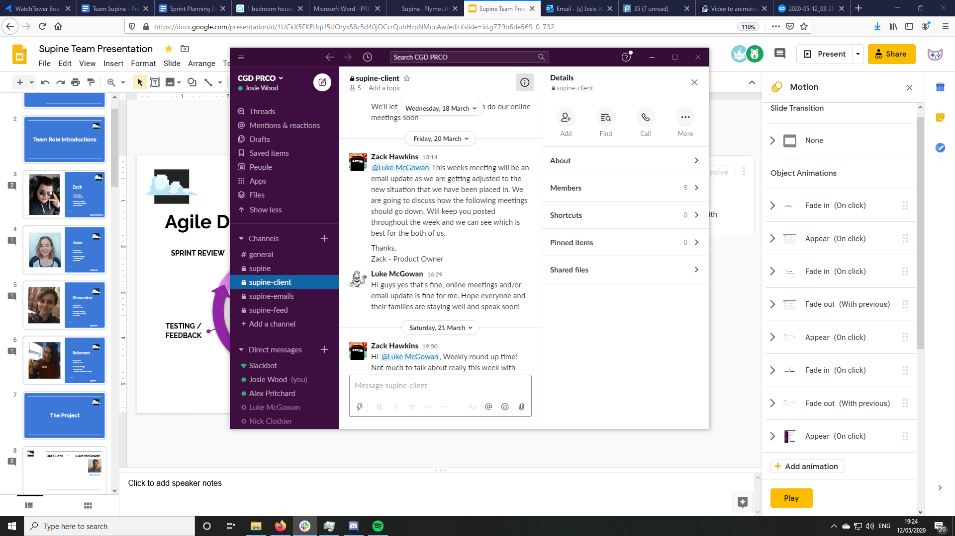
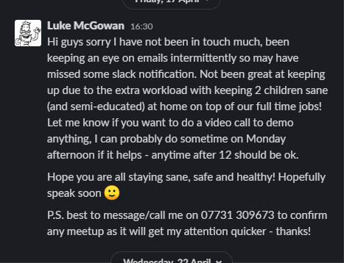
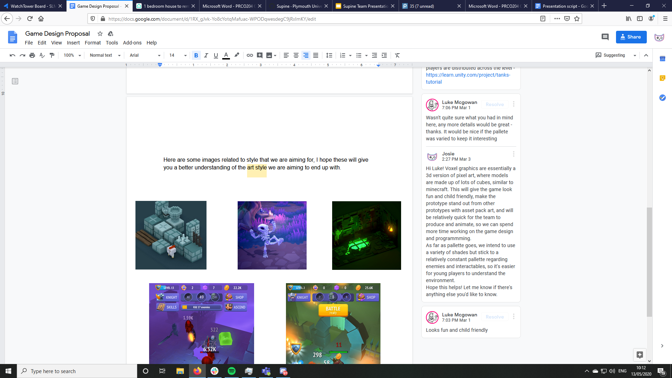
Establishing Communication with our Client
Shifted to Slack a few weeks into development
Easier to maintain constant contact
All team members could use the channel to talk with client
Met with Luke every 2 weeks to discuss plans and give updates
Got permission to record in-person meetings for later reference
Had to shift to online voice calls due to COVID-19 lockdown
Continued to give weekly updates on the Slack
Client stopped responding to Slack - had to reach out to secure new means of communication
Made initial contact from our supine.dev email
Sent a proposal for the game we could make for him
Resulted in being chosen as one of the teams to work for him
Notes:
After making initial contact with our client via email and proposing our idea to him, we established communication via “slack” a business communication platform. We agreed to meet in person bi-weekly to discuss major stress points about the project (art style, gameplay mechanics etc) and every week, I would write up a weekly roundup where I would take not of each of the team members doings in the week and post it to a specific channel that Luke could see and respond in if he wanted to. This continued to work for a few weeks until the COVID-19 situation. With the closing down of the uni and all moving online, we had to stop the in person meetings. We talked to Luke about this setback and he was ok with only doing the weekly roundups as he could message us about anything he had queries about. This went on for a while when it became apparent that Luke wasn’t responding. After bringing this up with the team I reached out to Luke asking about his absence, he responded and apologized for not checking slack as often as he should and suggested with all the issues caused by the COVID situation that I use his mobile number to contact him to set up meetings again. So with the team's approval, I texted him asking for a voice meeting, he agreed and we settled on discord as the preferred platform as all of us already had and used discord. With this, we had re-acquired voice meetings with our client after a blackout period.

Slide 12
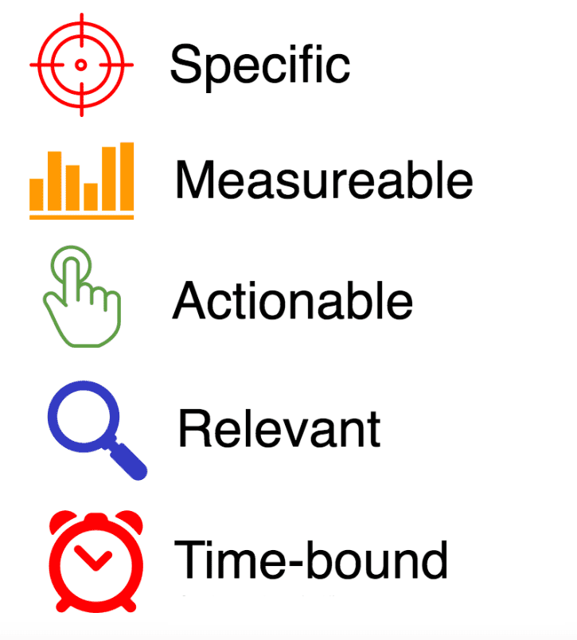
Agreed Objectives
Our objectives are:
Detailed
Quantitative
Can be improved upon or expanded
Have been applied to the client’s pitch
Achievable within the allotted time.
Child-friendly gameplay – no graphic violence
At least 3 levels of varying difficulty to keep gameplay interesting
Random generation of rooms to vary gameplay
At least 2 variants of enemies, with animations
Dungeon Crawler which works as a single player game
Child can connect to game using a webapp on a tablet with a unique code
Webapp has limited text and basic controls so it’s easy for young children to understand
Notes:
Following our initial discussions with Luke, we agreed on some objectives for the project. To be a success, we needed to cover the following
-It should be fun as a standalone game, so adults can play without their kids if they want
- Children can join the game as a second player on a tablet, as this is a lot more intuitive for small hands
-The webapp must have simple controls and minimal text so small children can learn it quickly
- Because it’s for children, we needed to be mindful of keeping it appropriate and not too scary
- To make it replayable, we agreed to have at least 3 levels with randomly generated rooms
-And finally, we decided to make at least 2 different enemies to demonstrate different styles of combat
In deciding these objectives, we made sure to follow the smart rules, keeping them specific, measurable, actionable, relevant, and time bound.

Slide 13
Agreed Technologies
Unity Engine (3D) – C# for player 1
HTML5, CSS3, JavaScript for player 2
Node.js server (currently hosted by Solomon)
Xbox One Controller (or similar) for the parent
Tablet controls for the child
Notes:
[SOLOMON]
Luke mentioned to us that he has experience in both Unity and web design which we took into account when deciding on the technologies to use. We opted for the 3D Unity Engine and C# - since we're already confident with it - and the basic web stack of HTML, CSS and JavaScript for the player 2 interface.
For the server, we stayed with JavaScript and used Node.js - a runtime environment for servers and backend processes. Keeping the language the same makes it easy to understand the interactions between the server and the client which is essential for expansion in the future.
For physical technology, the main game experience is designed for a controller (though it'll work with mouse and keyboard).
Through our discussions with Luke, we agreed that since the target age range for player 2 includes younger children: giving them a controller can be confusing or not even fit in their hands. However, many younger kids are experts at using touch screen devices, so we targeted a tablet for player 2 controls.
----
Introduce one by one, expanding and justifying where necessary
-(game loop isn’t dependant on player 2, can still win or lose without them)

Slide 14
Our Processes

Slide 15
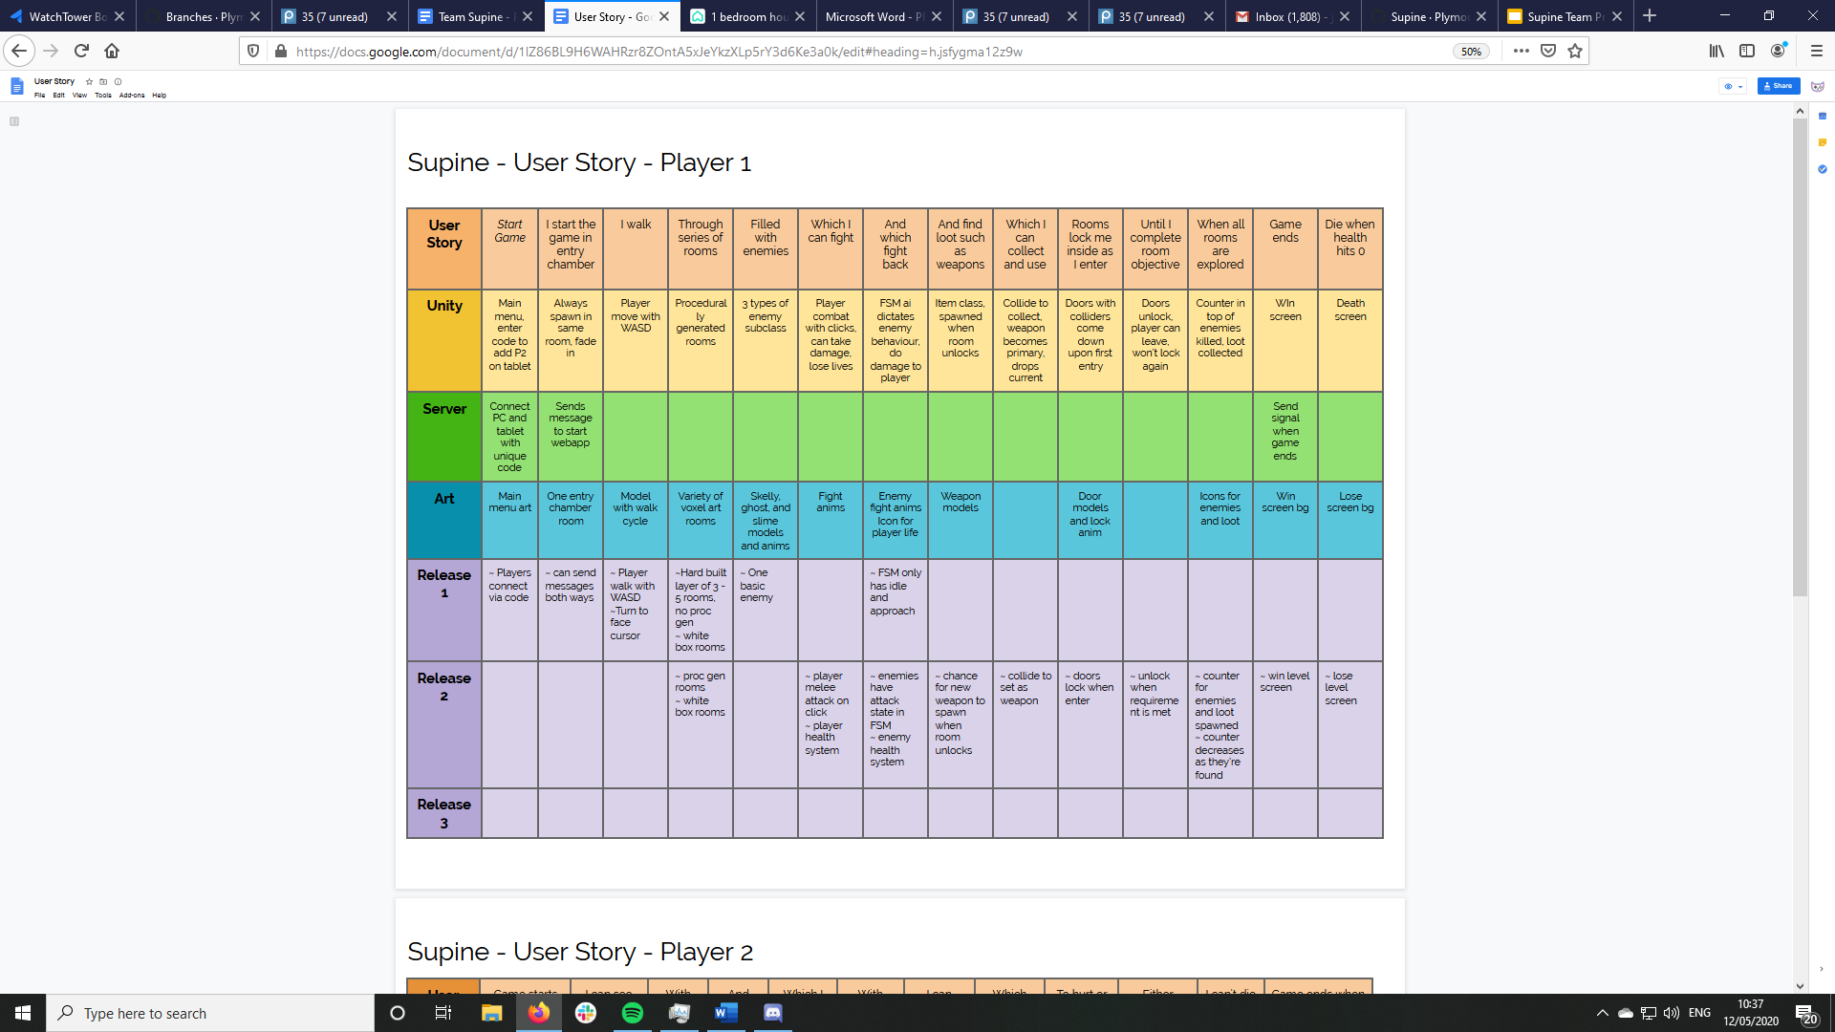
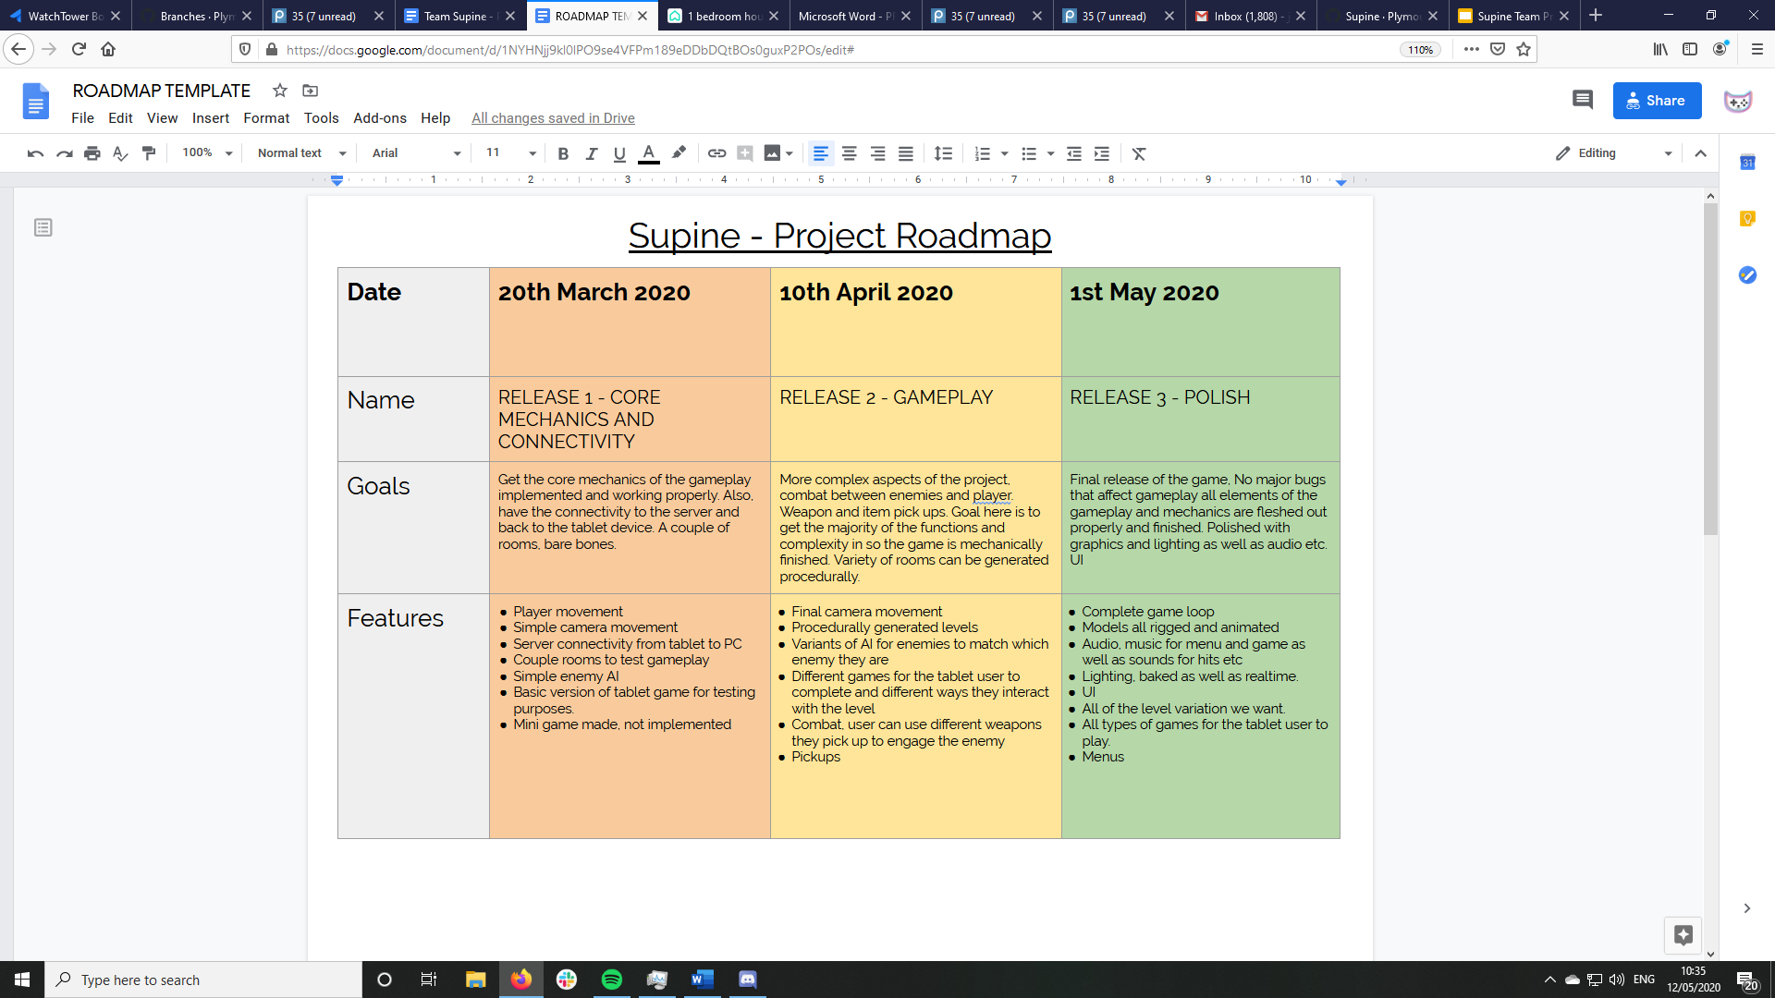
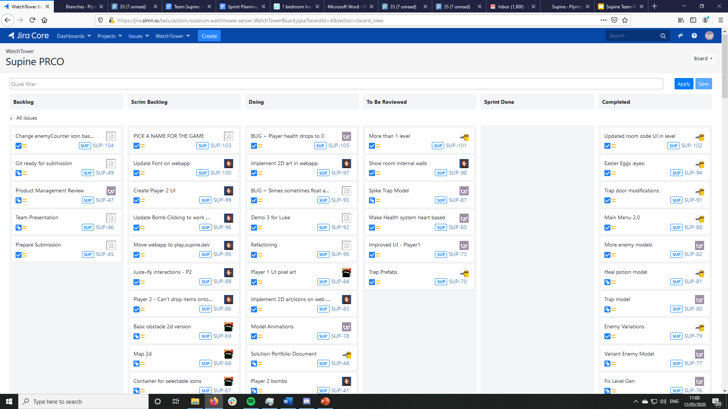
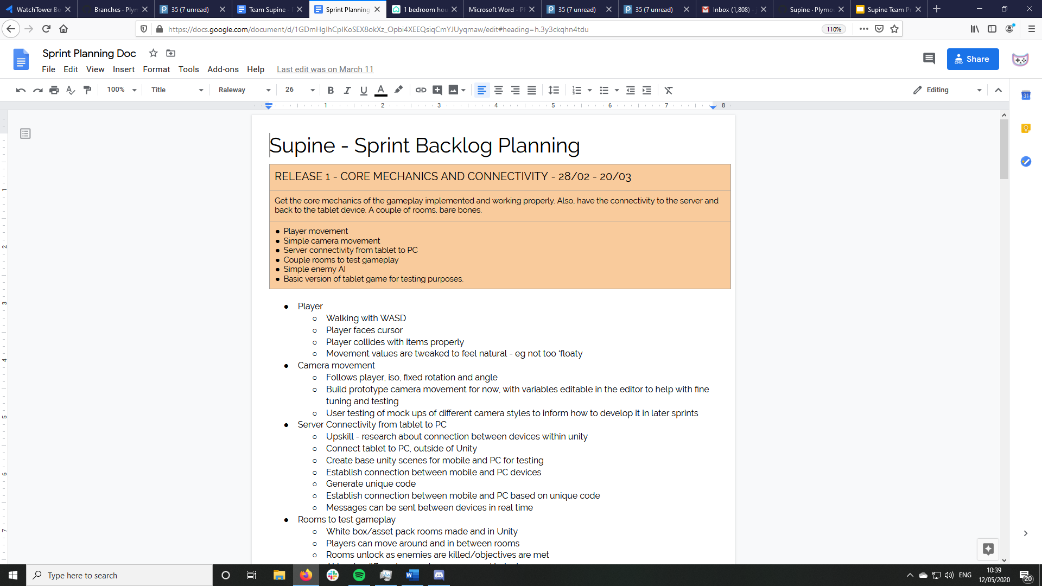
Agile Project Management
Objectives
Roadmap
Backlog Population
Development
Notes:
Once we had our objectives, our Product Owner Zack converted them into a roadmap, giving a blueprint for what goals we should aim to meet and by then.
From here, I began the process of backlog population, converting the roadmap into a user story broken down into deliverables. I broke this down further into a backlog planning document so I could clearly see all the tasks, before uploading each task to our Project Management Board in Jira. At this stage, a lot of the tasks were quite vague, keeping them flexible for future changes, as agile dictates.
With the backlog populated, we could begin our development cycle

Slide 16
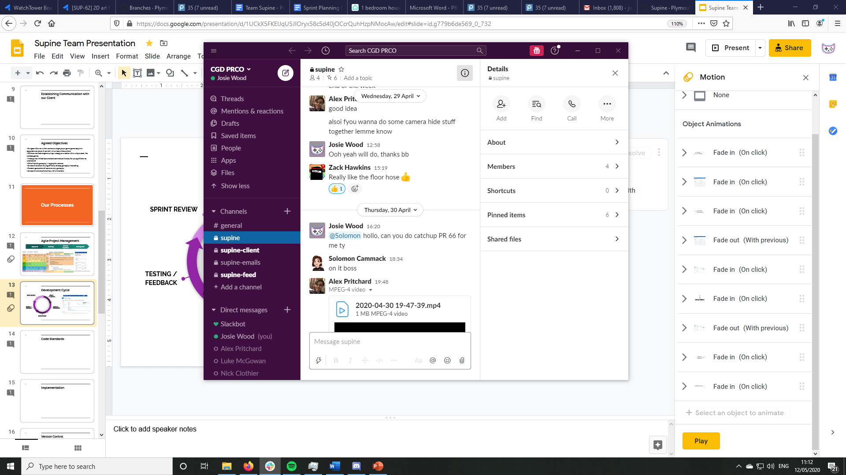
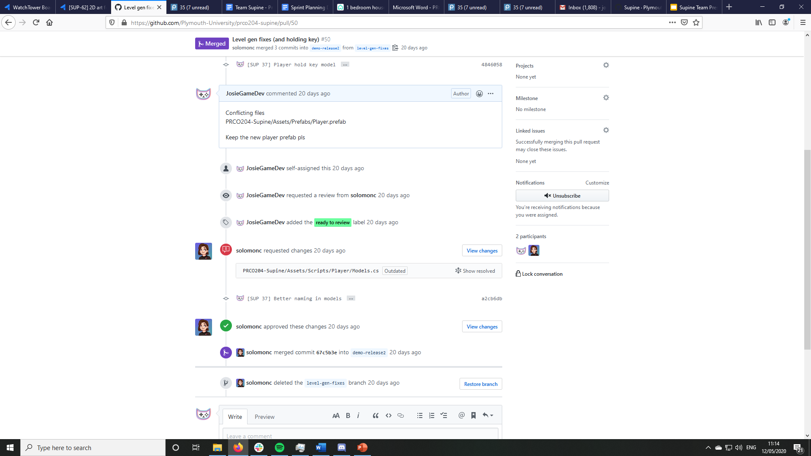
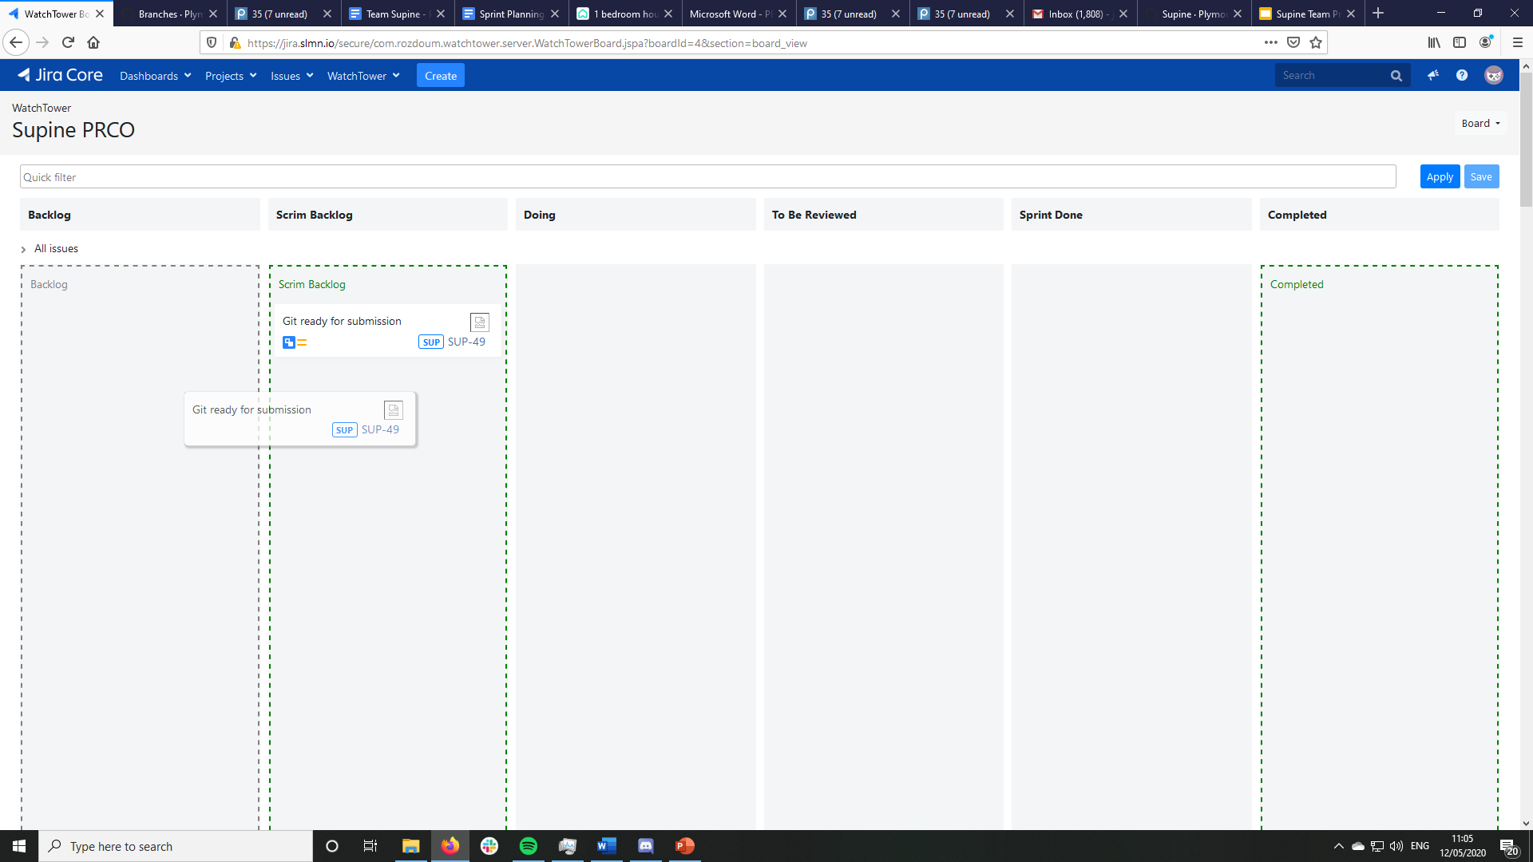
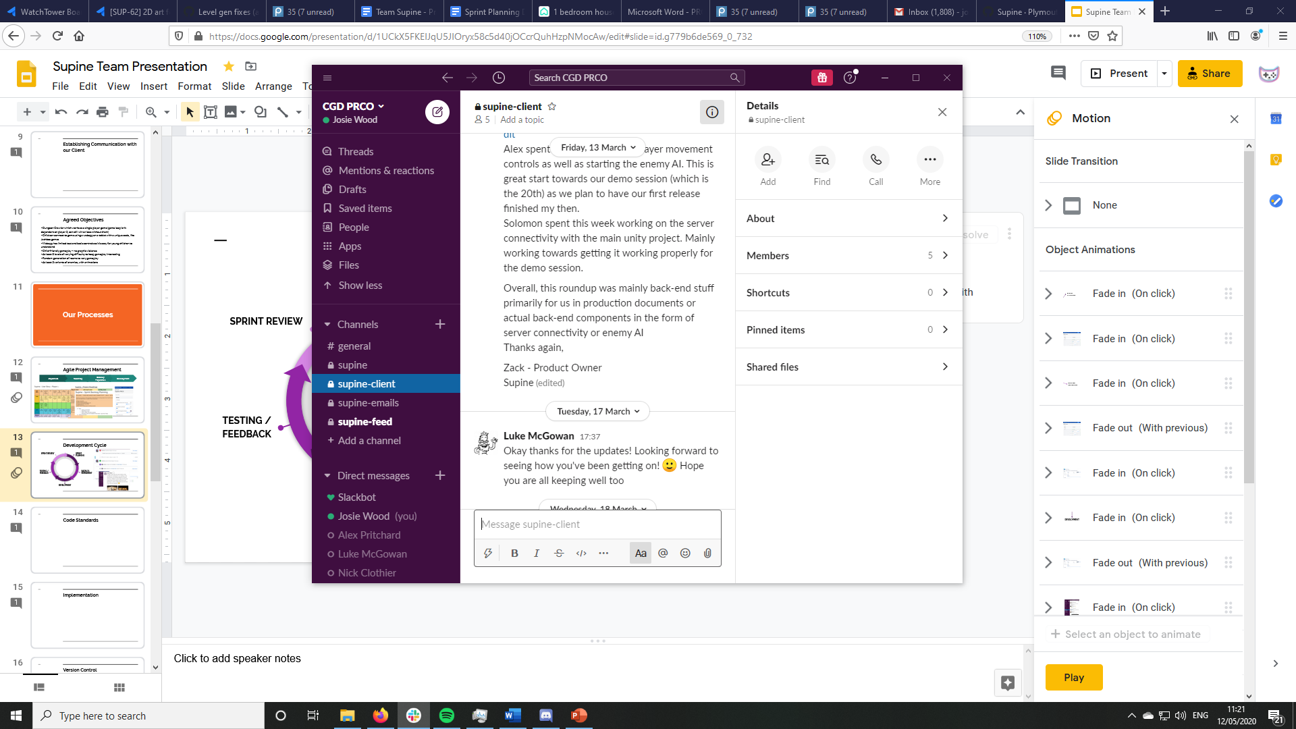
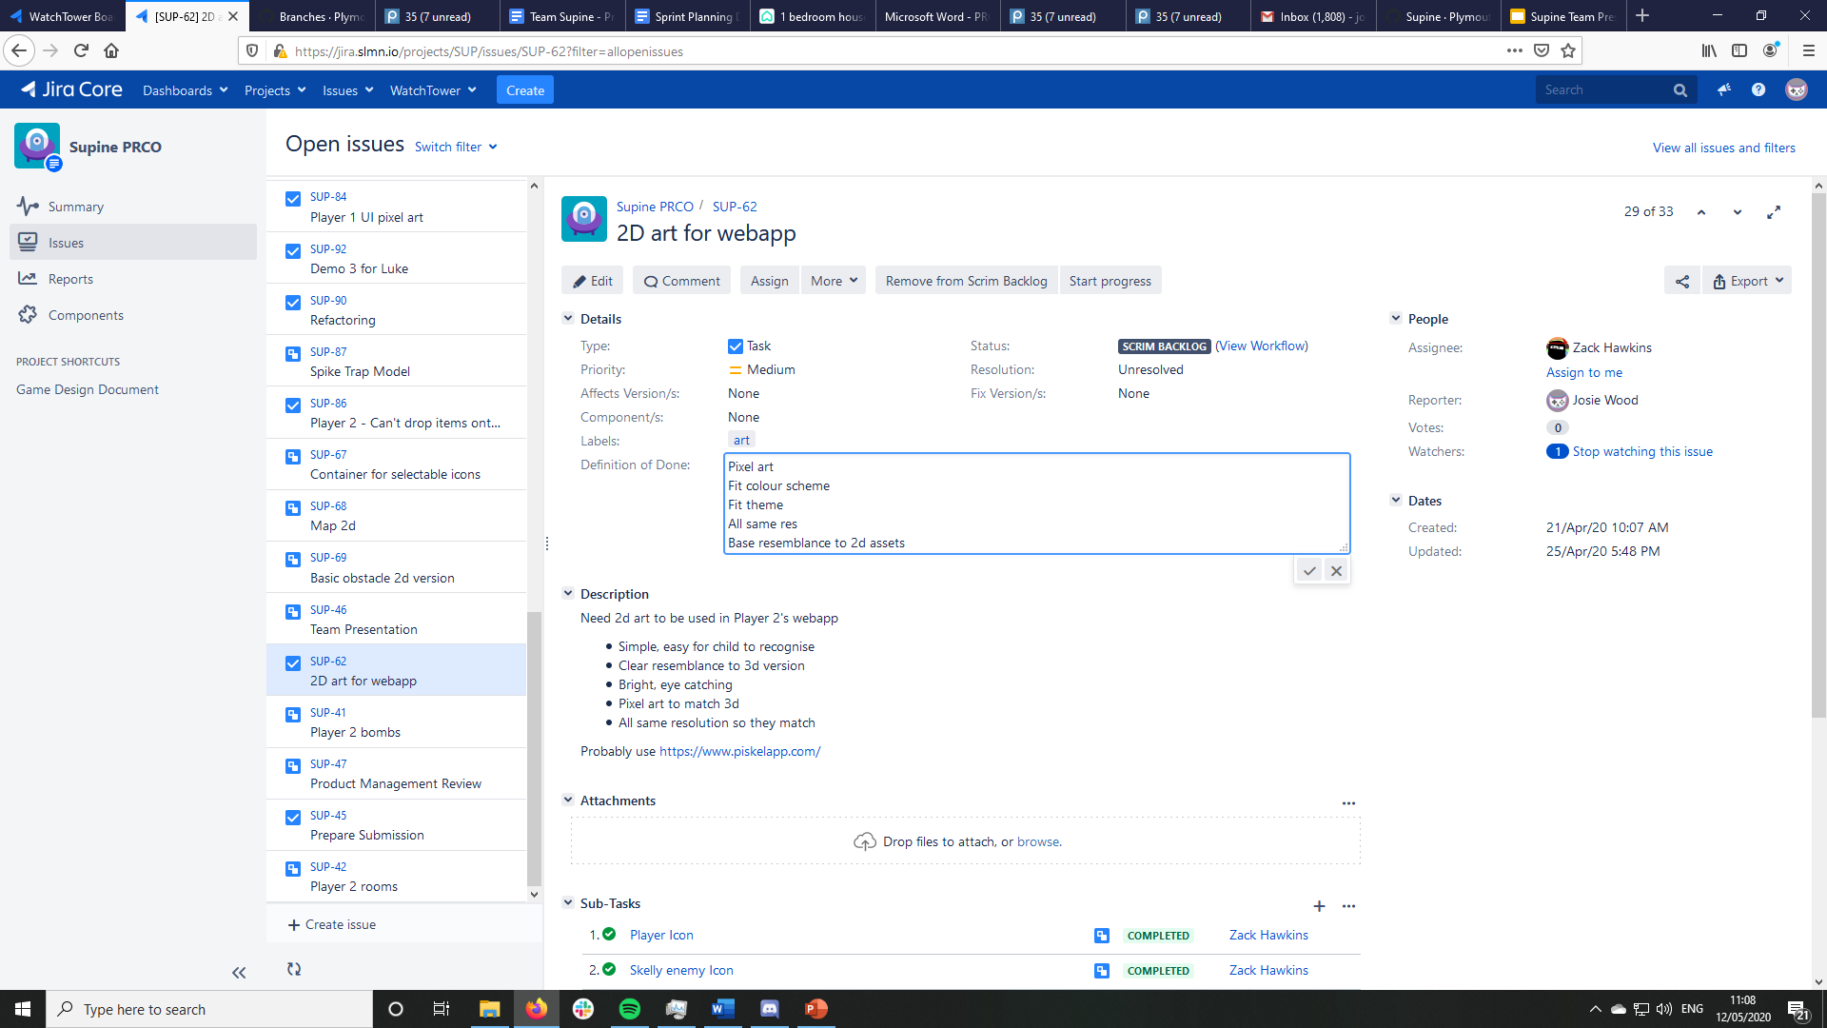
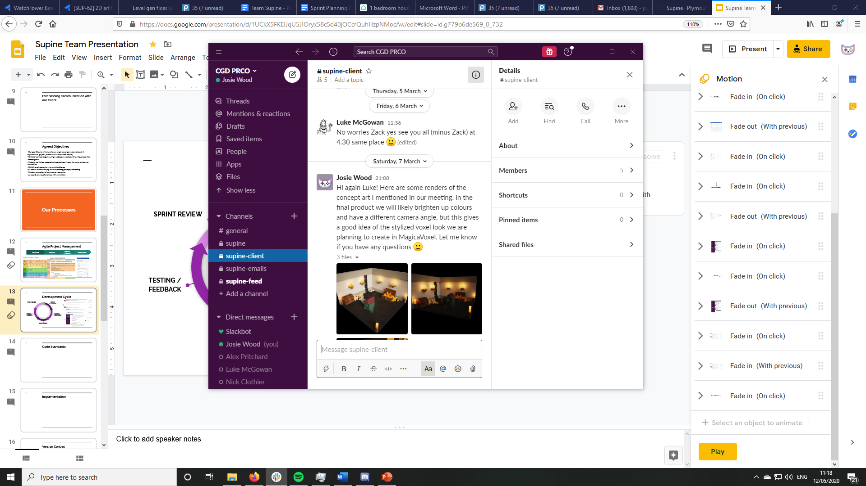
Agile Development Cycle
SPRINT REVIEW
SPRINT PLANNING
TESTING / FEEDBACK
BACKLOG REFINEMENT
DEVELOPMENT
Notes:
Each sprint started with a Sprint planning session - we would all get together, initially in Babbage, and later on via a voice call, to select items from the backlog to work on that week. We’d then move these tasks to the sprint backlog column, and go over some backlog refinement. For us, this meant reading through the task, adding or removing detail from the description as necessary, and all agreeing on a definition of done, to ensure we were all on the same page about what counts as completed.
Throughout development, we used Slack as a replacement for typical Daily scrums, as a place to bring up any issues and discuss what we worked on. This proved really useful when we had to make the change to remote working, as we had already established constant online communication channels.
With development complete, we’d start testing new features and getting feedback from one another and the client. This generally began with pull requests being made to merge our branches together, and our repo manager Solomon giving feedback on our work to ensure everything was at a good level. With everything merged, we’d work on QA testing to make sure there were no bugs or issues we’d missed while working individually, and we’d update Luke to get feedback that he was happy with what we were up to.
Finally, we’d meet up again for a review session, to catch everyone up on what we’d worked on that week and discuss any issues that arose so that we could plan the next sprint accordingly.
We followed this cycle throughout our project, with pre-scheduled meetings helping to keep us on track.

Slide 17
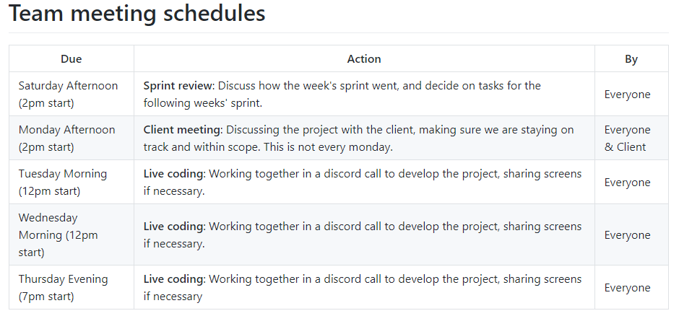
Team Meetings
January 2019 - March 2019: We met once a week for the sprint review, and communicated online the rest of the time.
March 2019 - May 2019: The Government enforced lockdown to tackle the spread of COVID-19 pushed us all to work remotely.
We added more frequent meetings to our schedule. These extra meetings really improved team morale.
From then on, we met:
Three times a week for a few hours of live coding in a call.
Once a week for the sprint review, sprint planning, and backlog refinement.
Once every two weeks with the client to update him on our progress and take suggestions.
This updated schedule was posted in the repo README.md, and reminders were posted in our team slack.
Notes:
These team meetings started off in person, during our module sessions in Babbage, however, as we entered lockdown we shifted to online meetings and scheduled more time together to keep up spirits and motivation. This included live coding sessions 3 times a week, the weekly sprint meetings, and meeting with the client roughly every two weeks to keep him as an active member of the team. Live coding sessions in particular helped us mitigate the issues that arose due to remote working - it encouraged us to continue working together on a regular basis, and gave us a chance to chat and resolve any issues we faced. We were flexible with the times to make sure everybody could attend, for example, we purposefully had two morning sessions a week, and an evening session a week so that team members with different commitments could make them. We added these meeting times to our github readme to hold ourselves accountable and make it easy for team members to find out when we were next scheduled to be in a call.

Slide 18
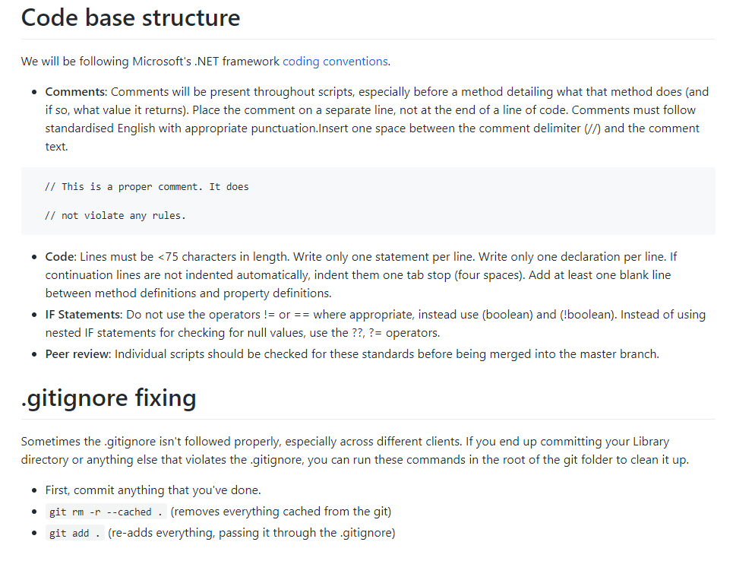
Code Standards
We followed Microsoft’s .NET framework coding conventions.
Most commonly used rules were posted in the project repo READ.md file so that members wouldn’t have to find them on the microsoft website.
All changes to code were peer reviewed before being approved and merged to the master branch.
Code that didn’t meet these requirements got rejected and needed to be reworked.
Notes:
I decided we would follow Microsoft’s .NET framework coding conventions as they are the industry standard. This was one of my first duties as Codebase Manager and was important as four different people needed to be able to read and understand systems and scripts that they didn’t implement or write. It was doubly important, however, because we have to hand off the proof of concept in its entirety to Luke, our client, and he needs to be able to understand the code enough to develop it further without us present.
Luke will already be familiar with these coding conventions as he has experience in game development already. they are also very well documented, so we could each follow them precisely without having to write up a new document from scratch listing them all. Nevertheless, I added the most commonly used conventions in the project repo README file so everybody has quick access to them if they needed reminding.
With help from Solomon, we reviewed all changes to the code before merging them into the master branch. Any code that didn’t meet these requirements got rejected and needed to be reworked and reviewed again. We repeated this process until the code met the standards perfectly.

Slide 19
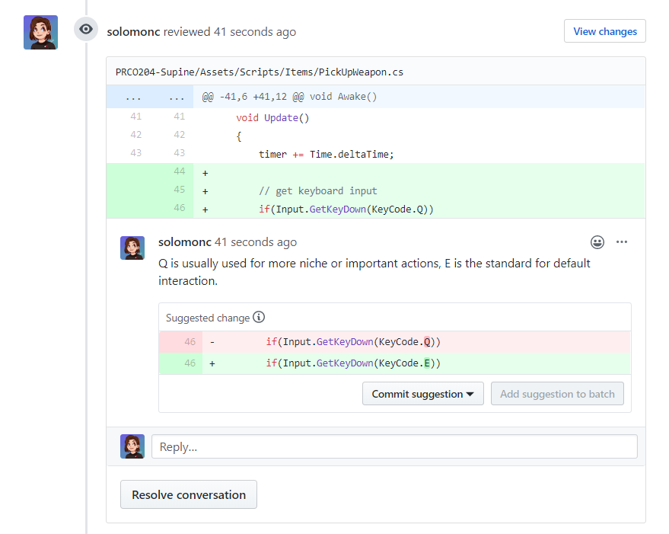
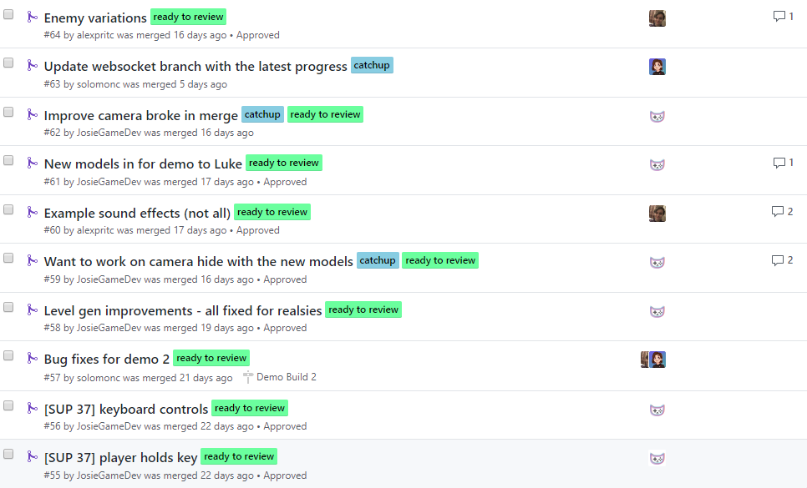
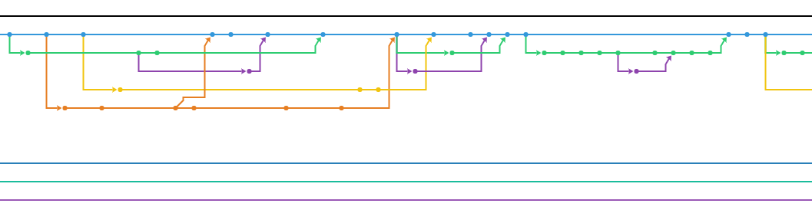
Version Control
Notes:
[SOLOMON]
As repository manager, I had the task of managing the project from the git side. At the start of the project, I outlined some version control conventions to make our lives easier as the project was underway. For example, each commit message should start with a Jira issue number it fixes. This integration helps us to track down issues and more explanation on Jira if we find some code that doesn't make sense.
Additionally, we used branches and pull requests heavily; we ended at around 80 pull requests merged. Each PR would be submitted by group members with tags, assignees and review requests all submitted. Me or Alex would review each PR to find code that could be refactored, didn't meet the coding standards, or didn't make sense. This system allowed us to keep our code at a high quality and make it easier to edit in the future (rather than letting more sloppy practices make it to the final versions)
I devised a version control schedule that turned out to be a bit too strict. It focused on deadlines for pull requests being submitted and then reviewed. In reality, we had to work together on most of the changes and try different ideas which required a looser window over the weekend.
After a few first commits without a gitignore, we didn't have many major issues regarding version control. Some branch merges were a bit of a head scratcher but we managed to use Github really effectively. By adding a webhook to our Slack, we could instantly see when work was being done or that a pull request had been opened.

Slide 20
Development

Slide 21
Implementation - Player 1
Player 1 is controlled by the user with a gamepad running the .exe on a PC.
Packages:
Unity’s preview input system for mapping controls
TextMesh pro for improved UI elements
ProBuilder for prototyping level design in early stages of development
Tools:
Used the animator as a FSM for enemy AI
Primary IDEs were Visual Studio and Rider
Written in C#
For more detail: Group Portfolio Document.
Notes:
Developing Player one happened purely in the Unity Engine and in C#, independently from Solomon and player 2.
I utilised Unity to fit the various needs of this project, including the core features of the Unity Editor as well as external packages that were installed specifically for use in the project.
I used Unity’s preview input system for mapping controller input because it’s a fairly new system that adapts well to the dev’s changing specification and presumably will be supported for quite a long time as it’s still in its initial phases and so Luke can continue to use it after we hand it off to him.
We used the TextMesh Pro package for improved UI that we had more control over. It was the perfect solution to the Unity Editor’s adequate default UI system as it adds formatting and layout features such as line spacing, links, custom styles, etc.
In the very early stages of development I used the ProBuilder tool (a package recently bought by Unity) to prototype different styles of level design. These did not make it into any releases, but they did make testing and prototyping a lot quicker.
I effectively used the animator in the Unity Editor as a Finite State Machine for our basic enemy AI. The enemy’s movement switches between two states: wandering and following. Wandering is when the enemy roams the map decided by random integers that dictate rotation times, walking times and the waiting times in-between. This, coupled with raycasts detecting walls, is a simple solution for creating enemies with realistic natural movement without having to develop complicated AI. The following state was simply to move in the direction of the player when the player is within a certain radius. Our artists also utilized the animator for its more traditional purpose of animating art assets to juicify them, bringing them to life.
More details on all of these tools and how we used them can be found in our group portfolio document.

Slide 22
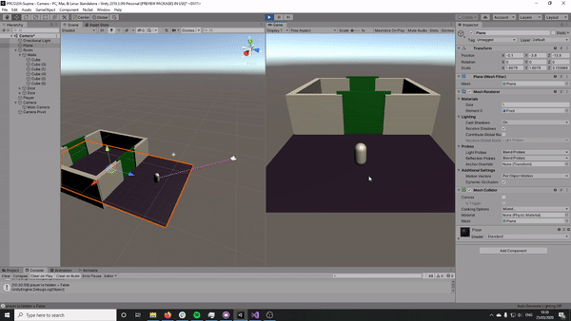
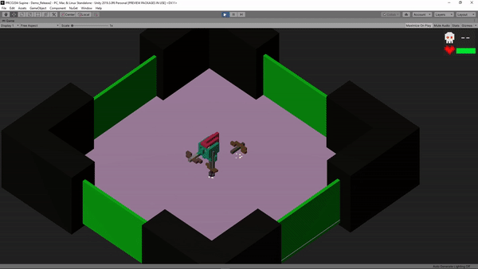
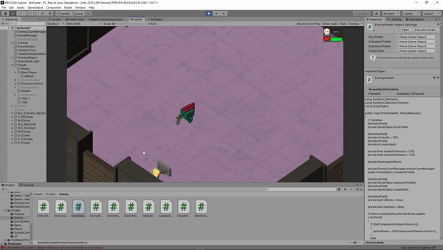
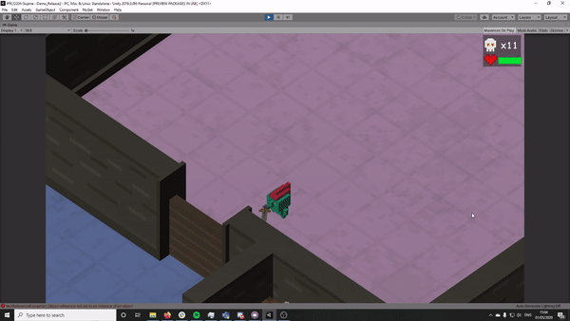
Iterations - Player 1
Sprint 6
20/03
Sprint 10
18/04
Sprint 11
28/04
Sprint 12
01/05
Notes:
We followed agile methodologies very well, as you can see here in these snapshots of our sprints. You can see the progression we made throughout the months of development, and how it exponentially grew very quickly.
By sprint 6 we had movement, doors unlocking, camera following the player, basic rooms. It doesn’t seem like a lot for 6 sprints in, but development in the beginning for player 1 was a lot of back-end systems that the user wouldn’t ever see. Once we nailed those, that’s when our vision really came to life, as you can see by sprint 10.
In just 4 sprints, we’d created weapons, item pick up systems, 3D art assets, an isometric camera view, particle systems, procedurally generated rooms, a health system and basic UI. And that’s just the front-end stuff that the user gets to see.
The focus of sprint 11 as you can see was adding ranged and melee enemies, which was an important requirement for our client. He wanted at least two types of enemies, and we essentially presented him with 3 as when larger slime enemies die they spawn 1 to 3 smaller, faster slimes that have a slightly different movement and less health.
By sprint 12 we had more detailed rooms as we had more 3D assets, a main menu system that responds only to controller input, audio effects, camera shaking effects, more in game UI, a functional camera hide feature when the Player is hiding behind a wall and trap doors to enter and exit the levels with. We also had a full game loop by this point, where the player can die and gets taken back to the main menu.
We have a lot more to show off as well, but I don’t want to spoil anything, so I’ll leave that for the game play showcase later on in the presentation.
What’s important to remember during these sprints is that we were also working on player 2 concurrently. We essentially had double the workload, and we managed to keep within scope and on schedule.

Slide 23
Implementation - Player 2
Player 2 is controlled from a web browser on a separate device.
Languages: HTML5 (layout) /CSS3 (styling) /JS (ECMAScript 6) (interaction & connection)
The web page connects to a Node.js server (written in JavaScript with socket.io) that acts as a relay to the Unity game (which uses a custom server handler based on WebSocketSharp)
Web-based controller means it can be run on any device regardless of specs or software. Socket.io servers are quick and easy to create and iterate on - perfect for agile development.
For more detail: Group Portfolio Document.
Notes:
Other players can join and interact with the game by connecting as "Player 2". The player 2 controller is a web app that can be accessed from any web browser on a PC, phone or tablet. It uses the normal web technologies: HTML5 for layout, CSS3 for styling and positioning and JavaScript (making use of the ECMAScript 6 specification) for interaction and communication.
To connect player 1 and player 2, we built a Node.js server that runs Express (a webserver) and socket.io (a websocket server for realtime 2-way communication). The server handles rooms using a 4 letter room code, and then it's mostly just a relay to send messages between the two devices.
Since both player 2 and the server have a common scripting language of JavaScript, they're very easy to integrate; node.js' servers were built to connect with the web. Connecting it to the Unity C# environment was a different story altogether and took a large part of the development time.
We enabled NuGet packages in Unity and used the WebSocketSharp package to handle the basic WebSocket communication. I wrote a fairly simple decoder for the specific syntax of socket.io messages (which is mainly opcodes and JSON messages) as the base.
Regular C# development can be quite different to coding inside Unity, so some of my more structured code had to be reduced to simpler options. For example, the player 2 item spawning system used to be a series of classes inheriting from an abstract Item class with a prefab each, but this proved to be inconsistent so it was changed to simple inspector variables.

Slide 24
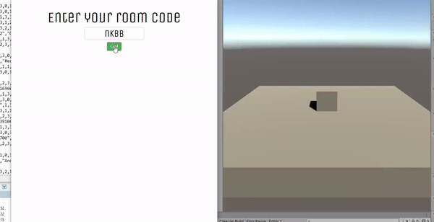
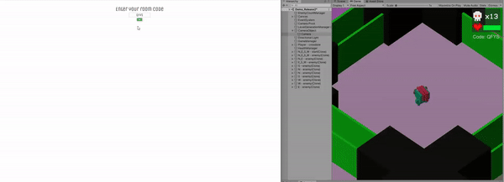
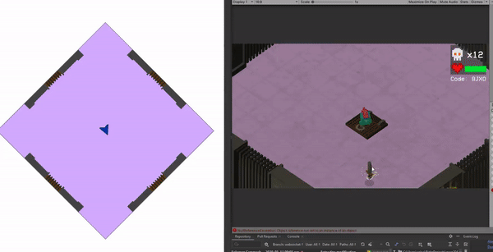
Iterations - Player 2
Sprint 3
28/03
Sprint 6
20/04
Sprint 13
12/05
Notes:
Our first sprints were focused on the two-way communication between the webpage and Unity. We need to make sure that Unity object data could be sent and displayed on web, and that gameobjects in the scene could be altered and instantiated from the web connection. I had a lot of trouble with threading errors here: anything called from a websocket message wasn't running in the main thread so it didn't have access to anything in the scene. The workaround was a buffered queue system where messages where queued in memory by the websocket thread and read from the main thread, which could then affect the scene.
As the sprints progressed, we added more to player 2's view to emulate more of the Unity scene. At sprint 6 we were rendering enemies across the entire scene at the same time across different rooms. We were then able to focus on the single room: applying the transformations to show a 2D orthographic view from a 3D scene and start to add some 2D art.
Most of the network data comes from Relays that are attached to objects that need to transmit data. Each relay contains a data property that is called every network tick. For example, the RoomRelay has data on the door status, floor colour and room type whereas an EntityRelay has data on position, rotation, entity type and health. By building smaller scripts that talk to a central ServerManager, it's very easy for other members of the team to work with the network - they simply add a relay to their prefab.
The final sprints use detailed 2D artwork based on the special layouts of each room, better animations and a touch friendly UI for interacting with the main player's scene

Slide 25
Testing

Slide 26
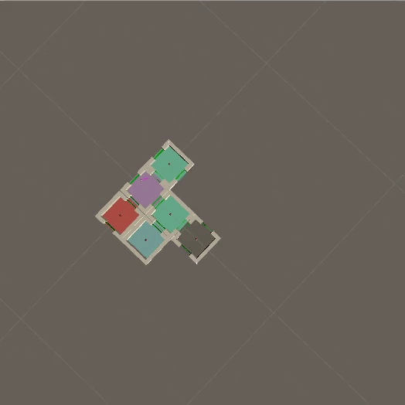
Quality Assurance Testing
Ongoing QA testing every week of development
Testing new features as they were implemented
Saved time and energy in the long run
For example: procedurally generated rooms.
During QA testing we found:
Rooms would occasionally spawn inside one another.
End rooms sometimes spawned infinitely.
Connecting rooms between two other rooms sometimes wouldn’t spawn.
By devoting time to QA testing, we were able to identify and solve these issues sooner.
Notes:
Josie and I were in charge of the Quality Assurance testing, which we scheduled every week. We worked remotely in a call, and tested each new feature as they were implemented to save time and energy in the long run (as we prevented people trying to debug code that they wrote a long time prior).
A prime example of this was with the procedurally generated rooms script. This was a big task that had many bugs in the beginning, most of which were hard to isolate the cause of.
We had debug.logs in the code so we could see what was happening in the in the Editor at run time, and we had rooms spawning when we pressed a key rather than automatically. We ran this hundreds of times, with different numbers of rooms, to isolate and reproduce bugs.
Some examples of the bugs that we found were rooms would occasionally spawn inside one another, end rooms sometimes spawned infinitely and connecting rooms between to other rooms sometimes didn’t spawn at all. By devoting this time to QA testing, we were able to identify and solve these issues sooner. If we hadn’t done this, we would have only been notified to these issues during User Testing, which by then would’ve been far too late to devote as much time to fixing the issues.

Slide 27
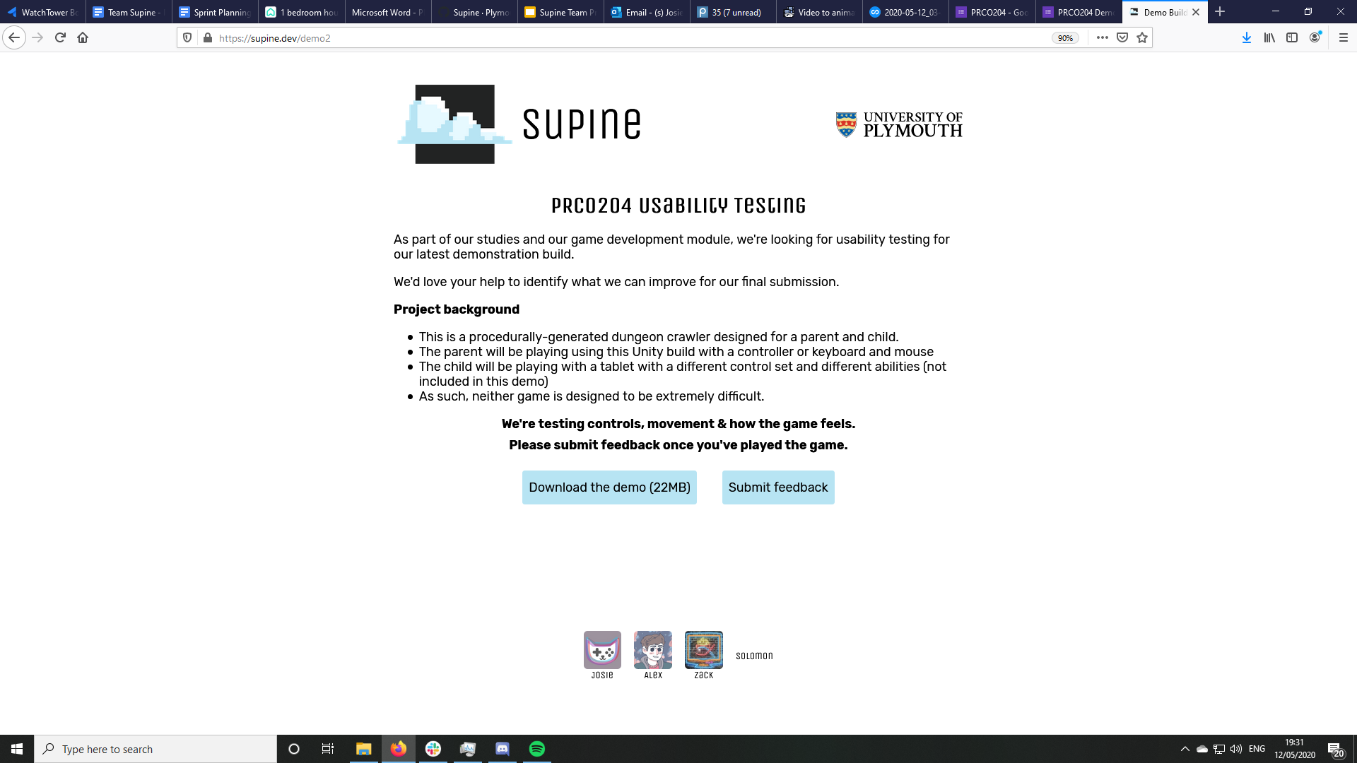
User Testing
Released two demo builds for user testing:
Initial responses to movement, camera, doors unlock
Feedback on changes, new camera, combat, styling, level gen
How they were organised, remotely:
Uploaded builds to our team site at supine.dev/demo
Shared this link with the public using university Discord channels, friends and family, to get a variety of feedback
Included links to Google form to gather responses
Gave detail on the background of the project
For more detail: Demo Release 2: Form (and responses).
Notes:
For our user testing, we went with a two test approach. This meant that we could test some core mechanics in the first test, make changes according to feedback and implement. We could then regather feedback on the changes to see if it was the correct call to make them. Our first test was to test the player movement, camera, enemy AI as well as the door unlock mechanics. After collecting feedback on these aspects, we made changes accordingly and after adding a few more features, created another demo release. This new demo was to collect feedback on the aspects we changed from the initial demo and see if we correctly adjusted them as well as collect new feedback on the new features that we added into this demo release.
We uploaded our demo builds to our team website with instructions on how to play the game as well as a bit of background. We then shared the link around public university discord channels as well other friend circles etc to collect a variety of feedback. One of the major concerns for using friends and family was bias towards us and skew the results. Unfortunately, this is something that is inevitable and the only course of action was to ask them to remain unbiased towards the test as the data we were collecting was valuable. We gave a link to a google form that contained some questions and ratings to gather our responses as well as organize them for us.

Slide 28
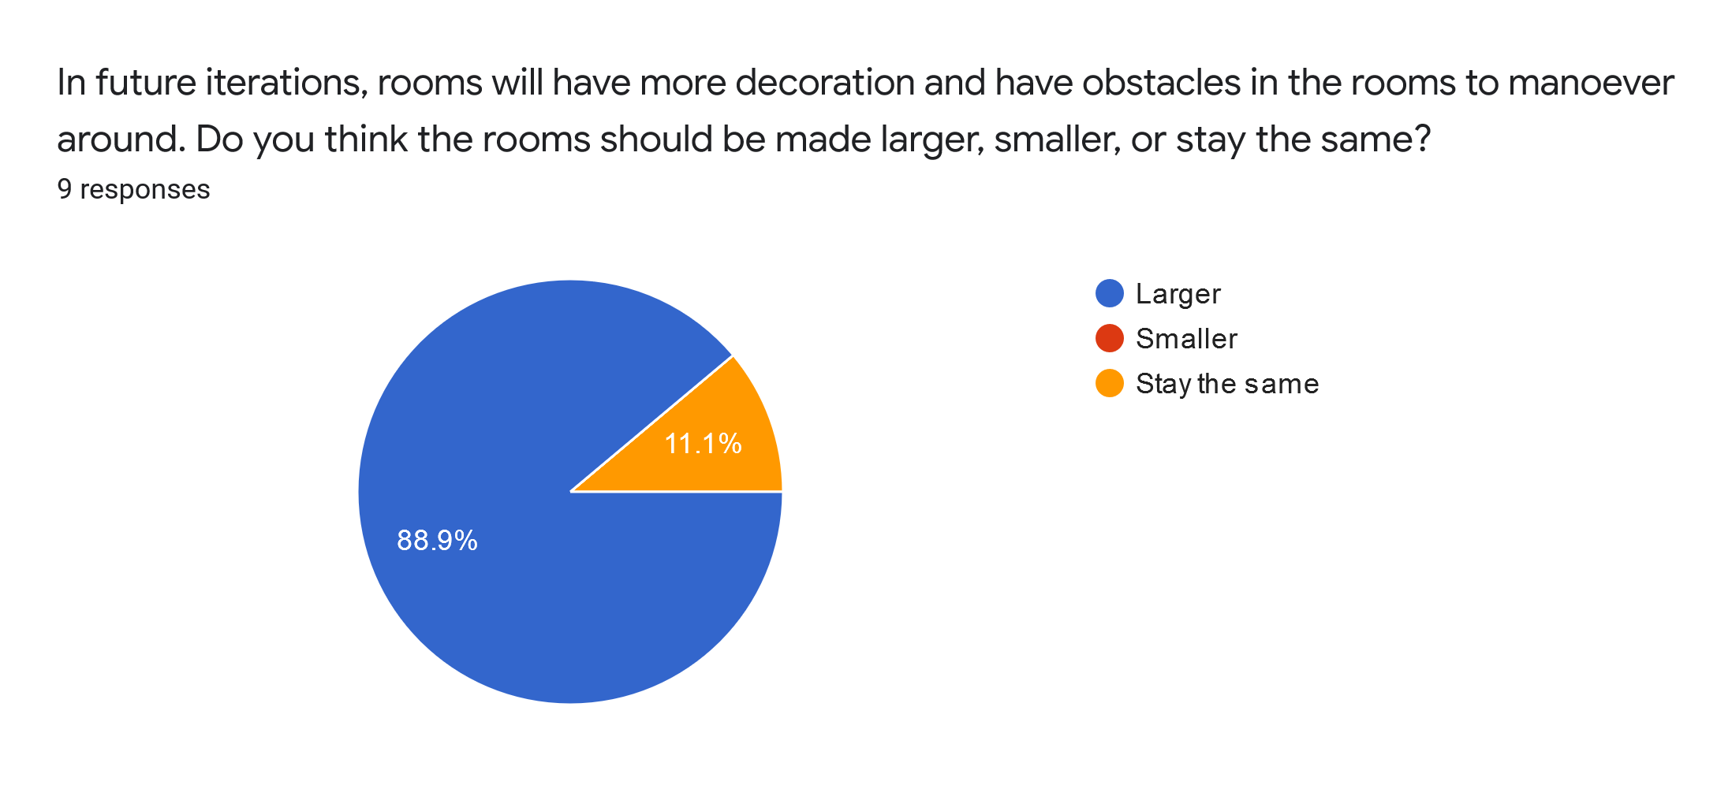
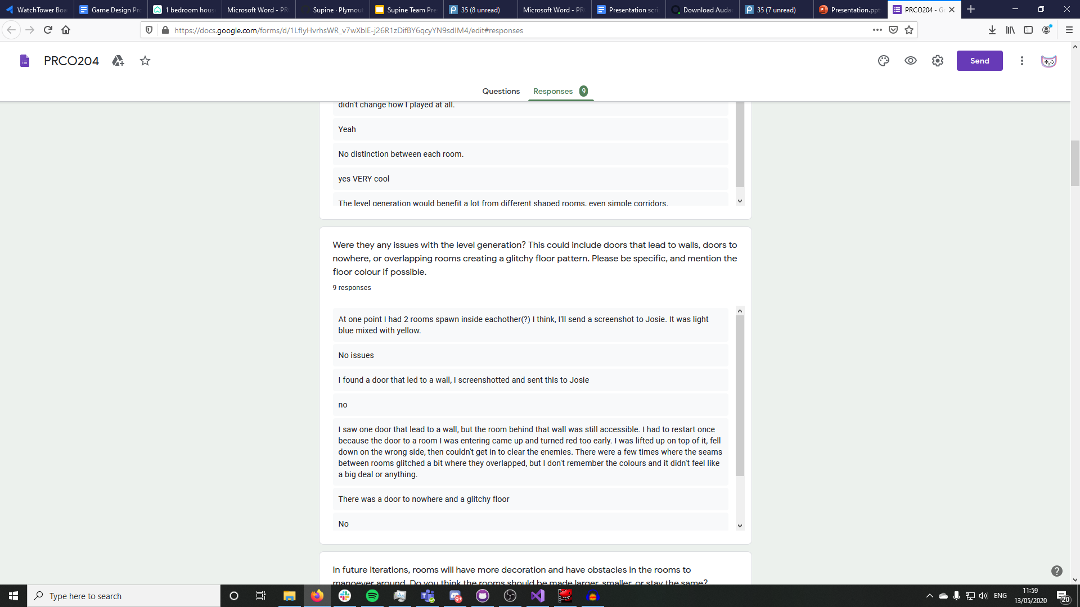
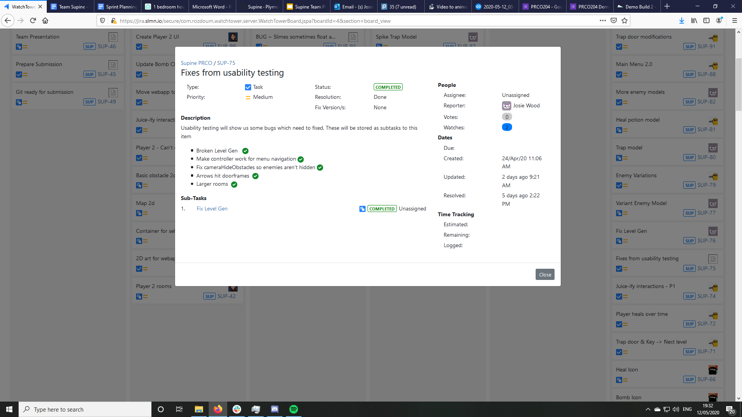
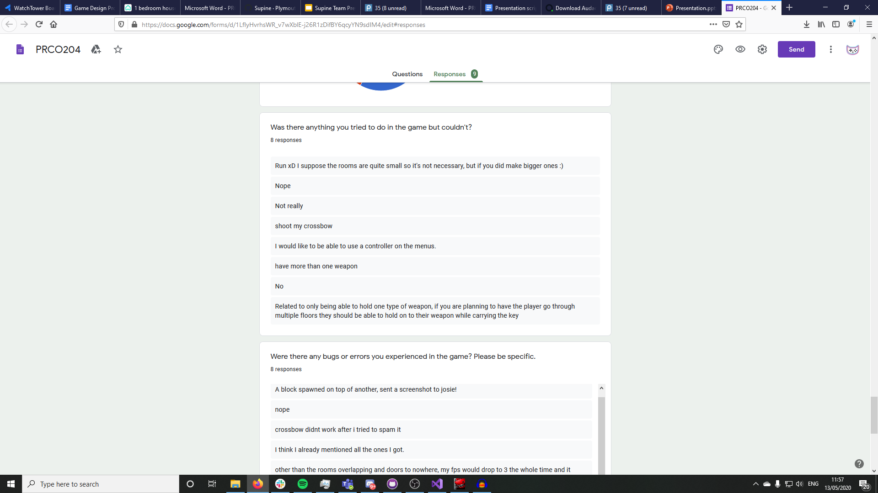
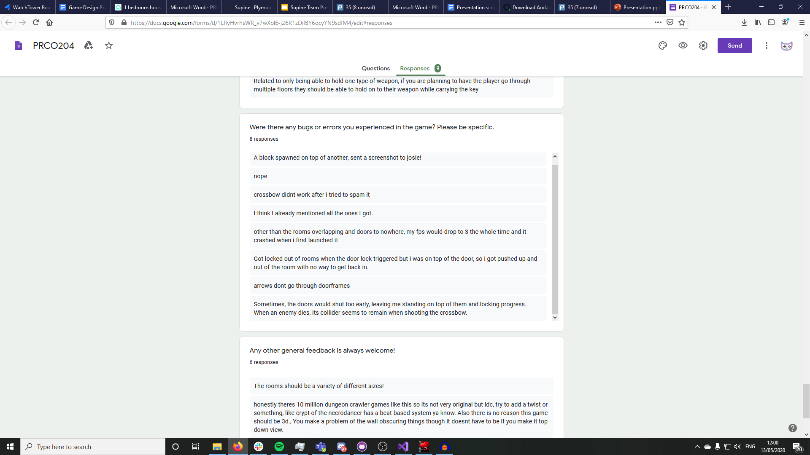
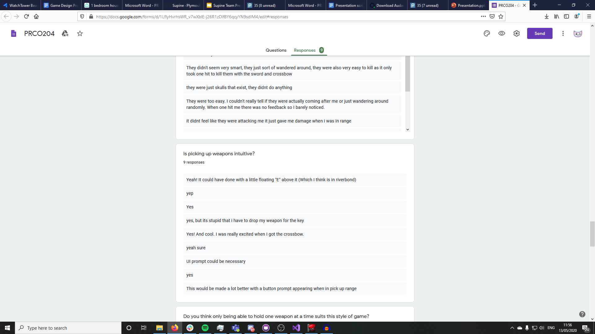
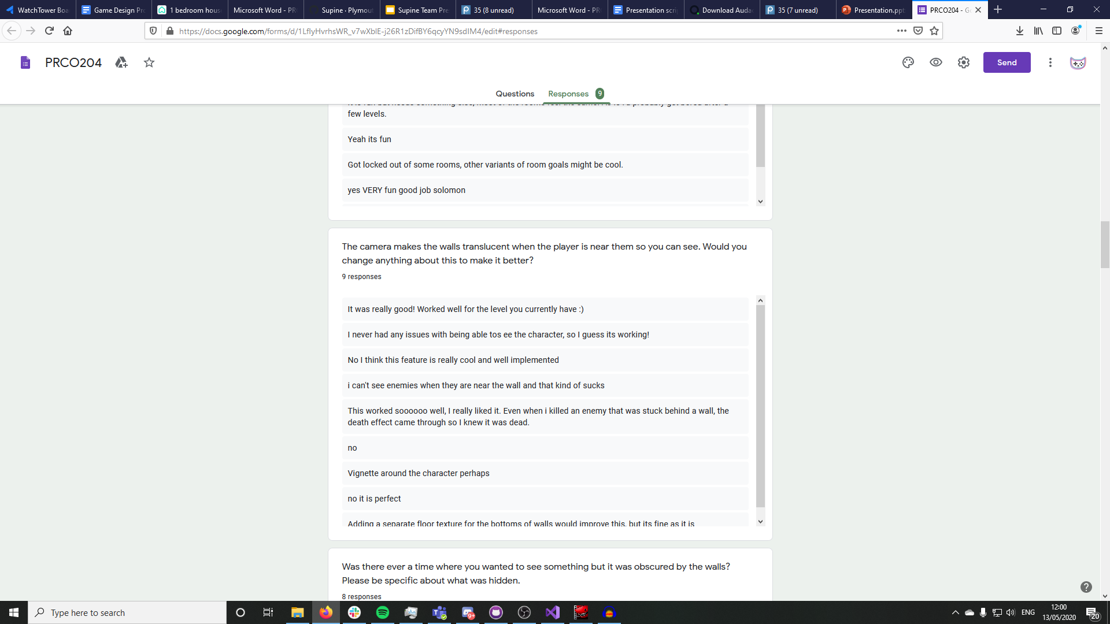
User Testing Findings
We summarised our findings in a usability response document
And identified which issues we could work on, adding them to a card on Jira
Identified a number of defects
Level Generation issues
Arrows exploding in doorways
Enemies hidden by walls
And got suggestions
Increase size of rooms
Use controller for menu navigation
Add prompts to weapon pickups
For more detail: Demo Release 2: Form (and responses).
Notes:
After waiting a few days for the forms to be submitted, we collected our results and examined our results.
From our first demo release, The feedback we got was useful. Considering this was testing our core mechanics, this was the time for major changes. For example, one of the major pieces of feedback we received was that our enemy AI wasn’t working. As this is a major aspect of a dungeon crawler this is something that had to be looked at. After the test was done, we created a jira post that contained all the issues from the test. After a team discussion it was decided what to act on and what to change and or not change. Because we were making changes to the core mechanics, we had to leave enough time to complete the rest of the project. We decided that the enemy AI should be re-created from the ground up as it was better to start again than to fix what we already had.
After collecting this data and making the changes where appropriate, we added some of the other core mechanics of the game (procedural generation of rooms, picking up weapons) and refining some of the other aspects of the game we released our second demo for testing. Again, after waiting a few days for our results, we collected and analysed them.
The decision to rework the enemy AI was a good one, the feedback on the new system worked much better than the first. Even though there was some feedback on the new system, they were minor changes. The aspects we improved upon from the first test were received positively. It showed us that we made the correct choices when deciding what to change / improve.
By doing two user tests, we were able to collect feedback from the first, make improvements and test the improvements. This was key in refining and creating the game that we intended from the start.

Slide 29
Results

Slide 30
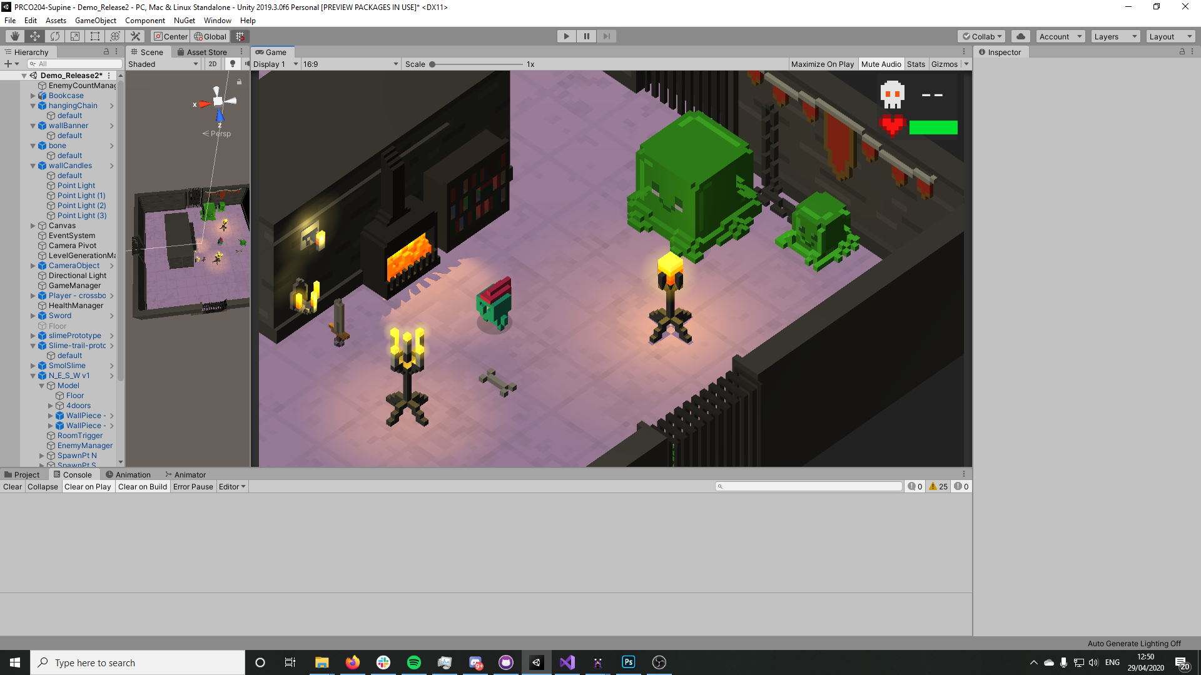




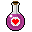




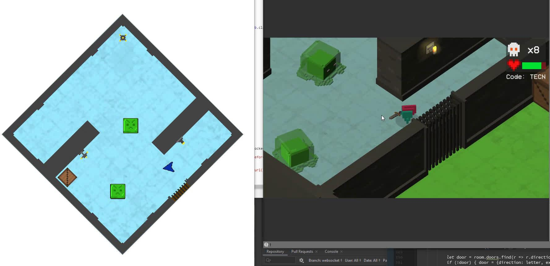
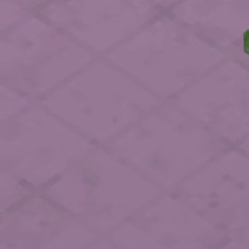
Assets
Custom art (2D & 3D)
Unique
Child-friendly
Retro and arcadey
8-bit sound effects
Tailored to clients needs
Library of assets created for future use
Notes:
A key part of our project was that we did all our own art. As a team with 2 artists, we were able to create unique art to make our client’s proof of concept stand out. We chose voxel graphics for the main game, made in magicavoxel, because the basic blocky shapes balance looking professional while also child friendly. Luke also stated he liked this retro, arcadey aesthetic that it brought to the game, especially as it matched the 8-bit audio that Alex created using BFXR, a free software tool for game developers to create juicey sound effects.
Making our own art assets, we could also tailor them to the needs of the client and the project. Since our game has both a 3D main game and 2D second player mode, we needed graphics that could easily represent game objects in both of these formats. Zack worked on pixel art for all the 2D aspects of the game, which matches the voxel based graphics of the main game really well.
Because we made all the assets ourselves, we’re able to leave our client not only with a proof of concept, but also a library of original assets he can use himself to develop the project further as he so wishes. Also, these individual assets can be easily put together, like lego, to create new room designs to make even more unique levels.
It took a lot of work, but we’re really happy with how the visuals and the audio turned out, it really ties the game together.

Slide 31
Final Product
Tap Tap Dungeon:
[insert playthrough video here]
Notes:
So here it is, our final product: the game “Tap Tap Dungeon” as it stands today. We still have a week of potential development left to work on it before we hand it off as a proof of concept to Luke and get his sign-off on it, but development has now essentially ceased.
We have discussed how the hand-off will take place. We plan to have one final remote meeting with him where we talk about possible options for the project in future, and what our involvement could look like. This is particularly important as Solomon is currently hosting the server, and Luke may want this to continue. Furthermore, we would be open to discussing freelance work to help maintain and develop the systems in place.
Here is a video of the full gameplay with no commentary.

Slide 32
Links
Agile development:
GitHub Repository
Project management board (Jira)
Game Design Document
Group Portfolio Document
Scrum Overview
The final product (coming soon):
Play.supine.dev
Itch.io page
Supine:
Supine.dev
The client:
Luke McGowan’s Linkedin
Notes:
Here you can find links to our team’s documents and the relevant websites, including the initial Game Design Document we made in January and our project management board. Our released proof-of-concept will be available to download on itch.io within the next week, after we’ve handed it off to Luke and gotten his sign-off on the project.

Slide 33
Reflection
What went well:
Maintained constant communication with the team and university staff
Followed agile principles throughout
Good proof of concept - easily expandable
Development continued steadily despite change to remote working
What we could have done better:
Better handling of implementation of Player 2
Made more time for testing
Worked harder to ensure all team members understood all aspects
Handled team relations more professionally - more blunt when issues arose

Slide 34
Thank you!
Any questions?
Notes:
Thank you for listening, we will now happily answer any questions you might have!

